Slide 1
Cooking with AWS and Splunk
Module 10: Collecting Data from AWS Container Services
Kam Amir | Splunk Cloud Architect

Slide 2
Agenda
AWS ECS Logging in Fargate
CloudWatch Logs approach
Sidecar with Docker Logging Library (Future)
Splunk Universal Forwarder (EC2 only)
Data Collection Method
Lambda Function
Kinesis Firehose (Future)

Slide 3
AWS ECS Logging in Fargate
Note EKS Fargate will be covered once it’s available

Slide 4
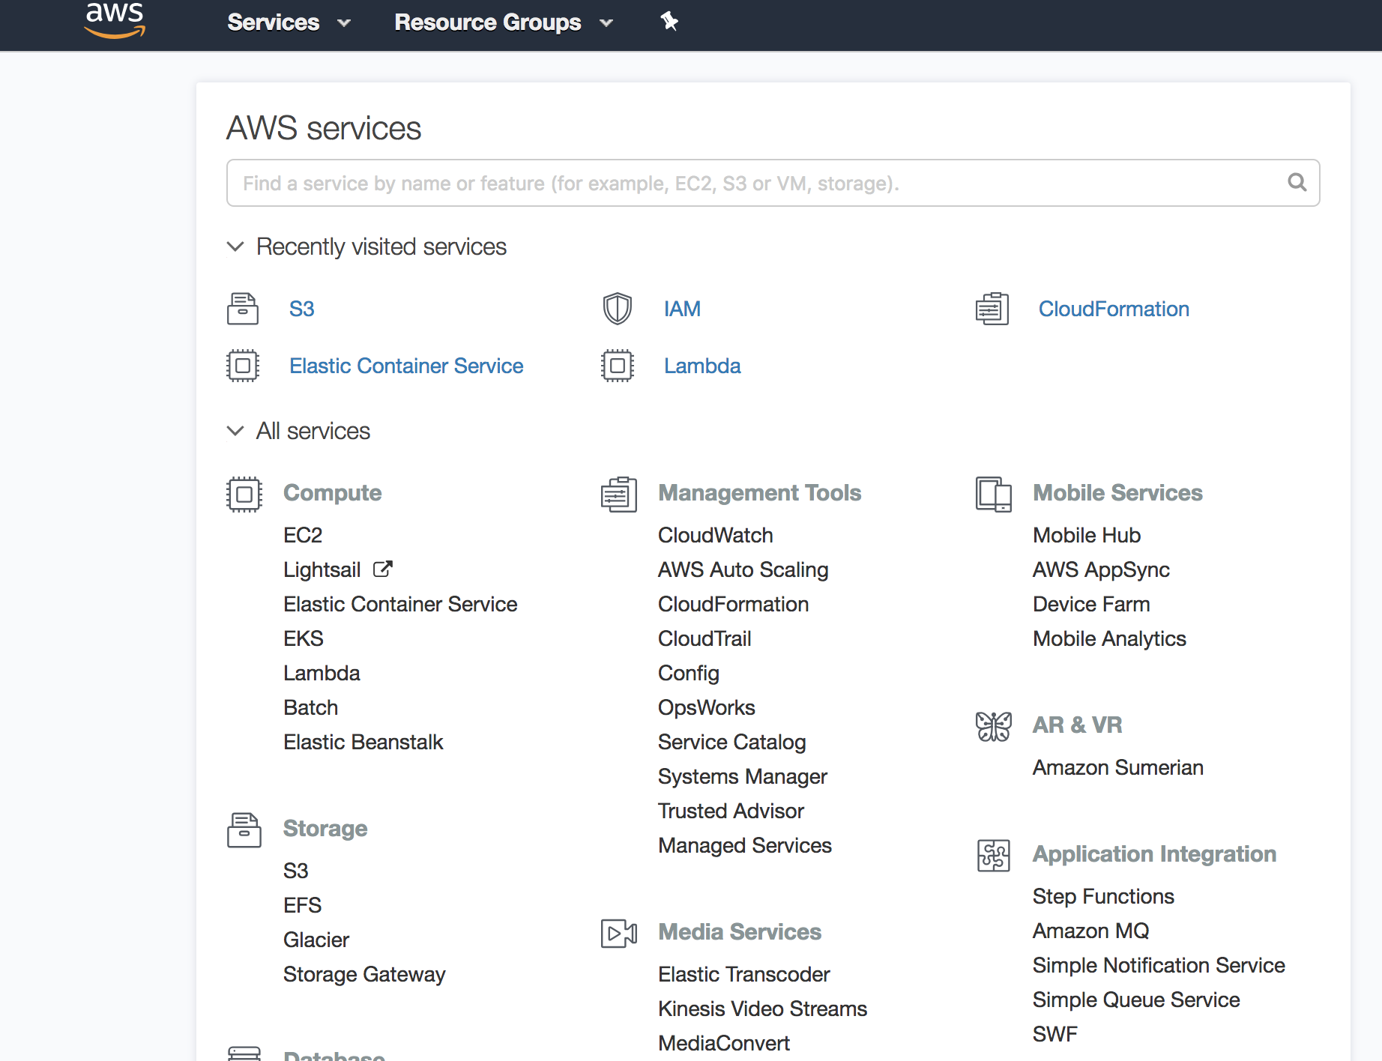
Setting up Logging for ECS
Step 1 of 10
Click on Elastic Container Service

Slide 5
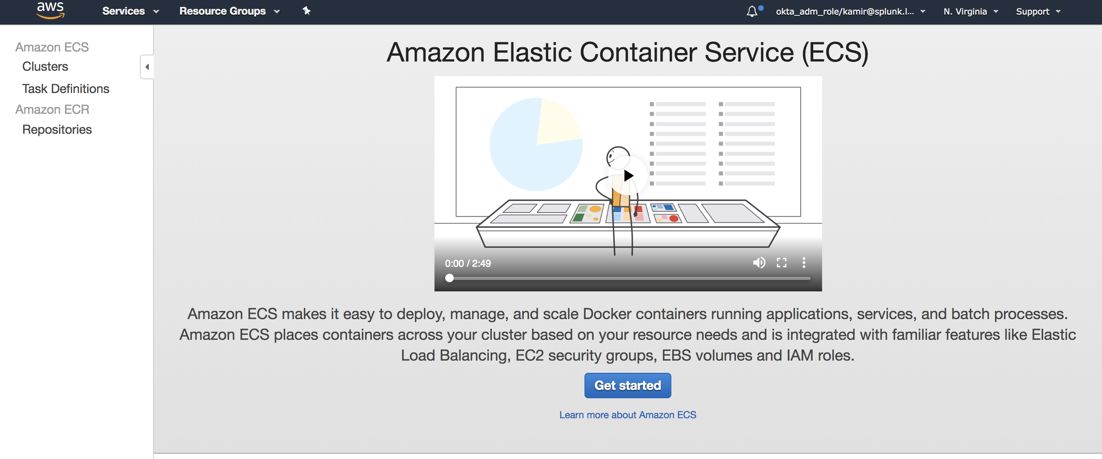
Setting up Logging for ECS
Step 2 of 10
Click Get Started

Slide 6
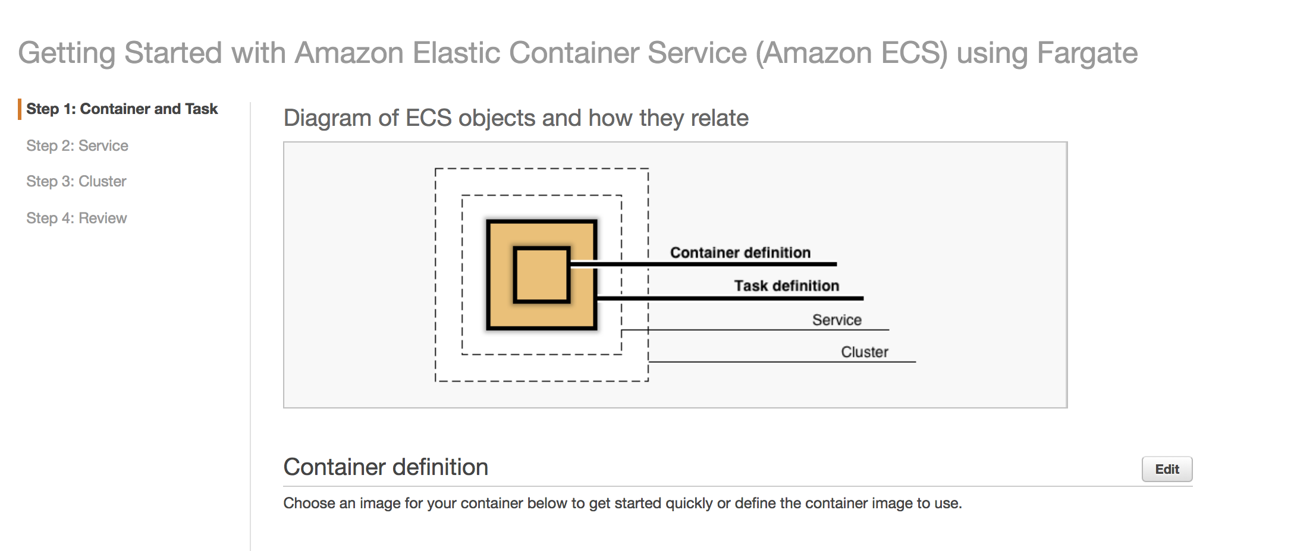
Setting up Logging for ECS
Step 3 of 10
Click Edit

Slide 7
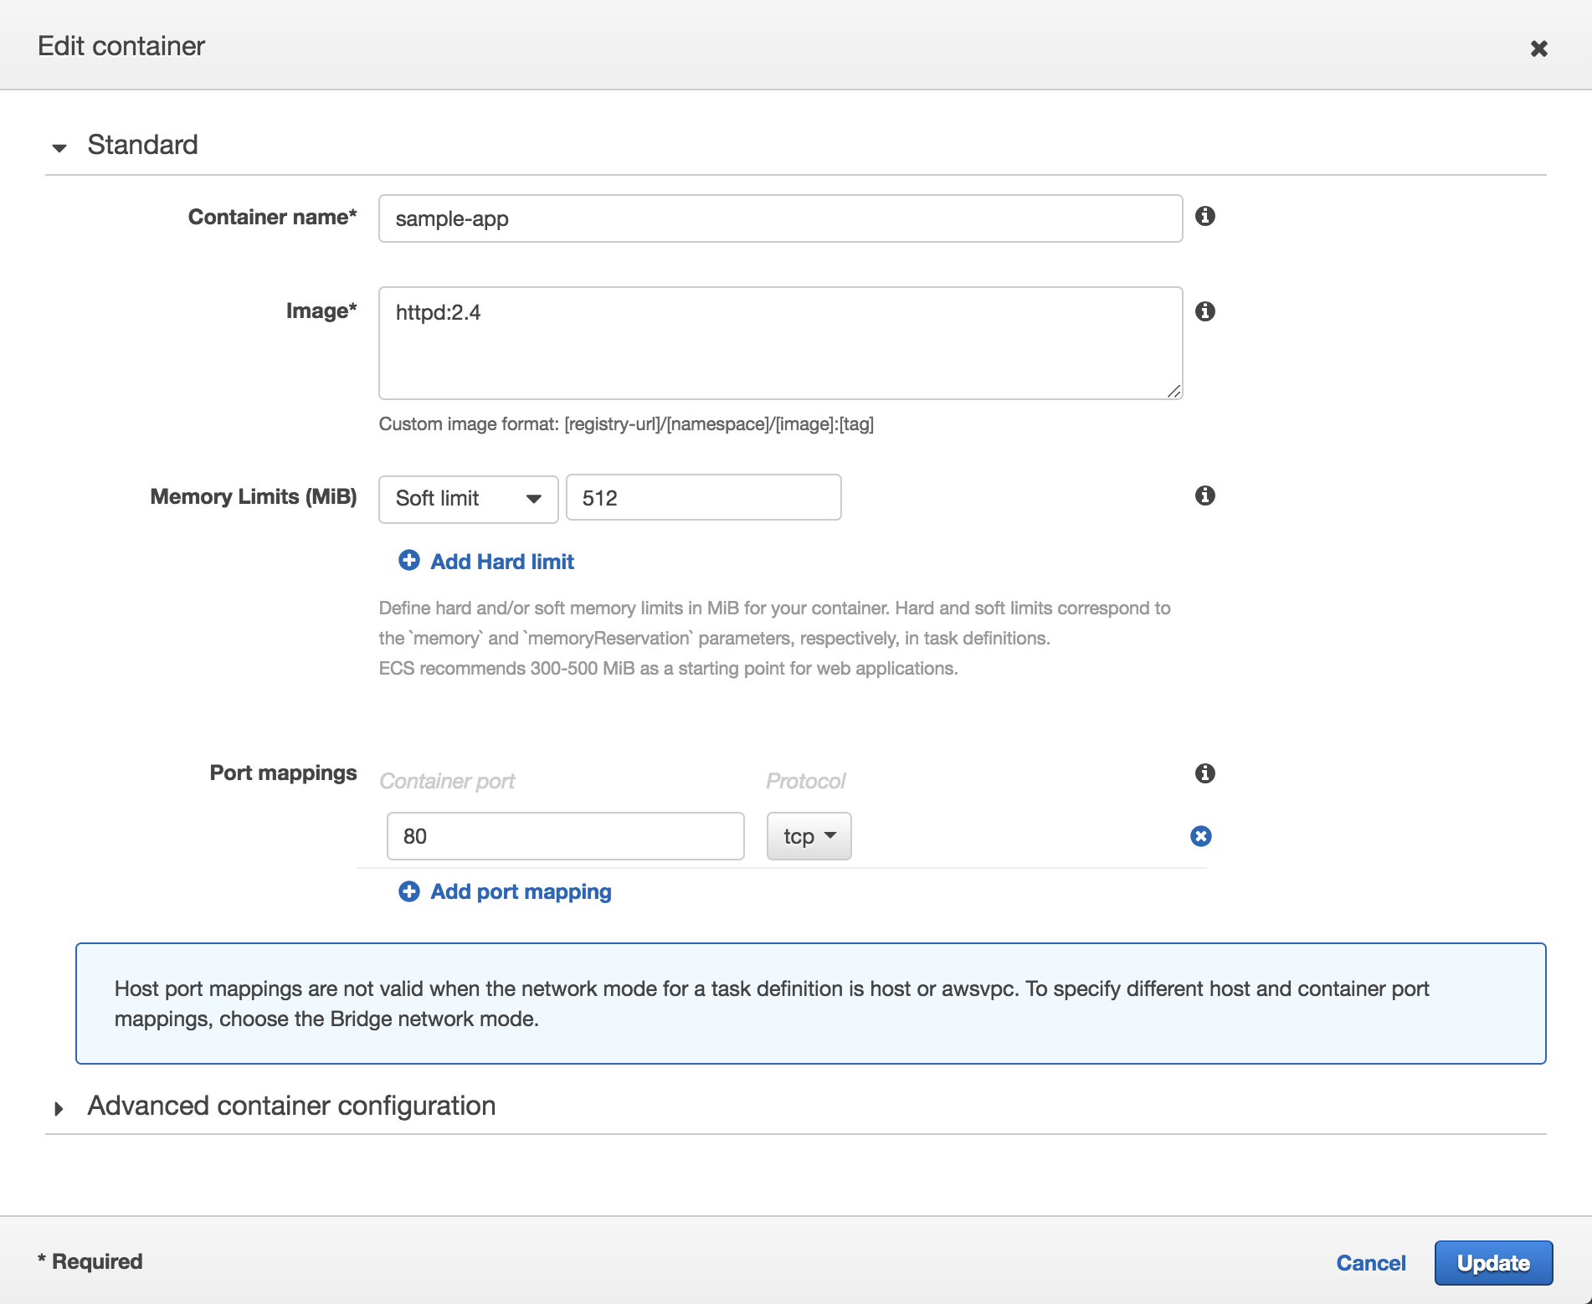
Setting up Logging for ECS
Step 4 of 10
Click Advanced container configuration

Slide 8
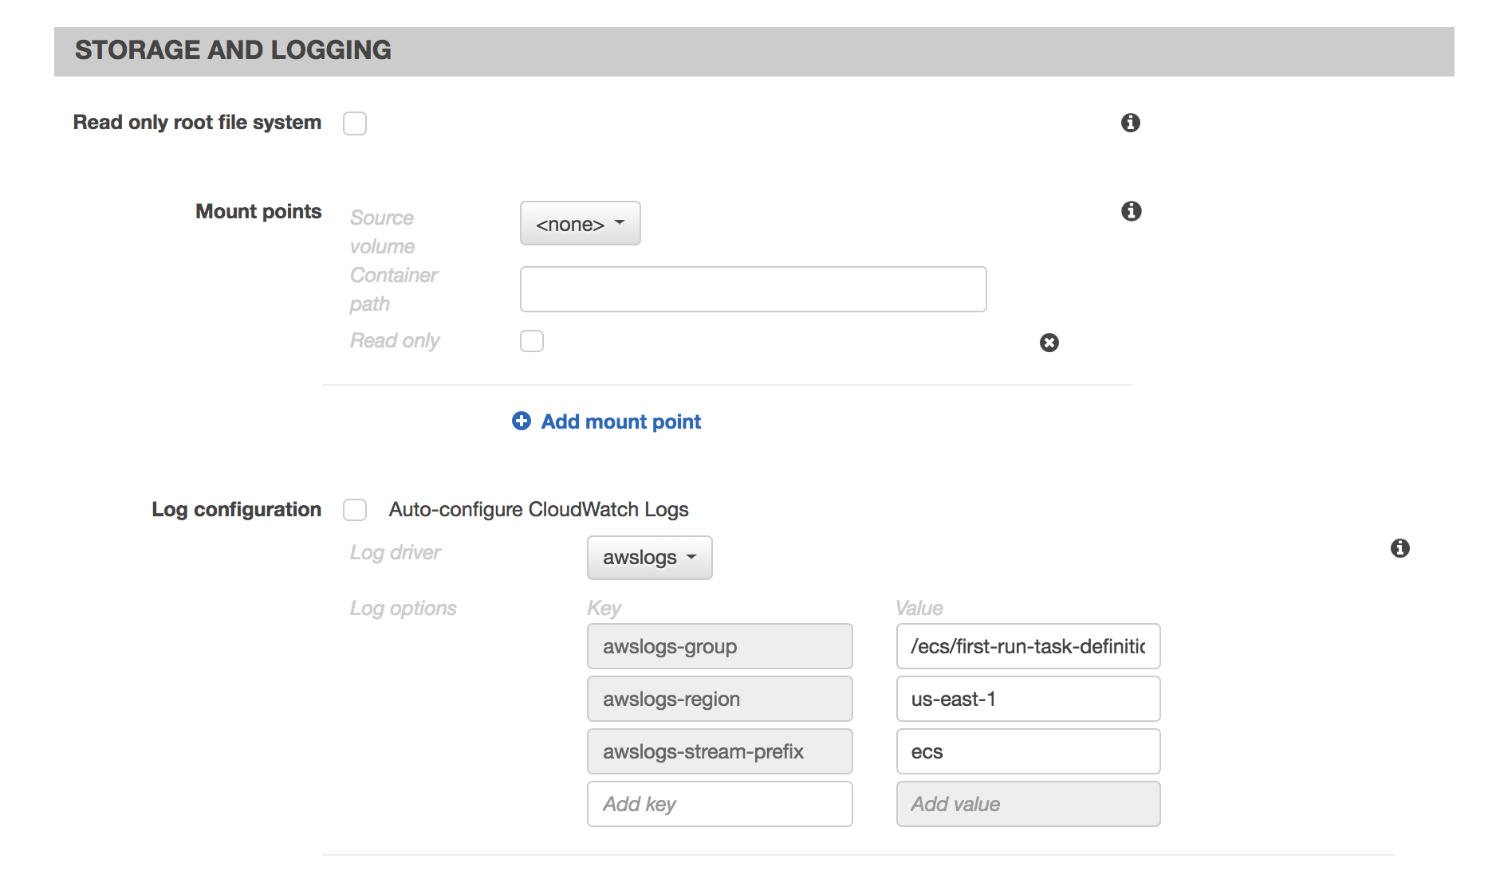
Setting up Logging for ECS
Step 5 of 10
Scroll Down to “Storage and Logging.”
Enable “Log Configuration"
Copy the CloudWatch Log group created here.

Slide 9
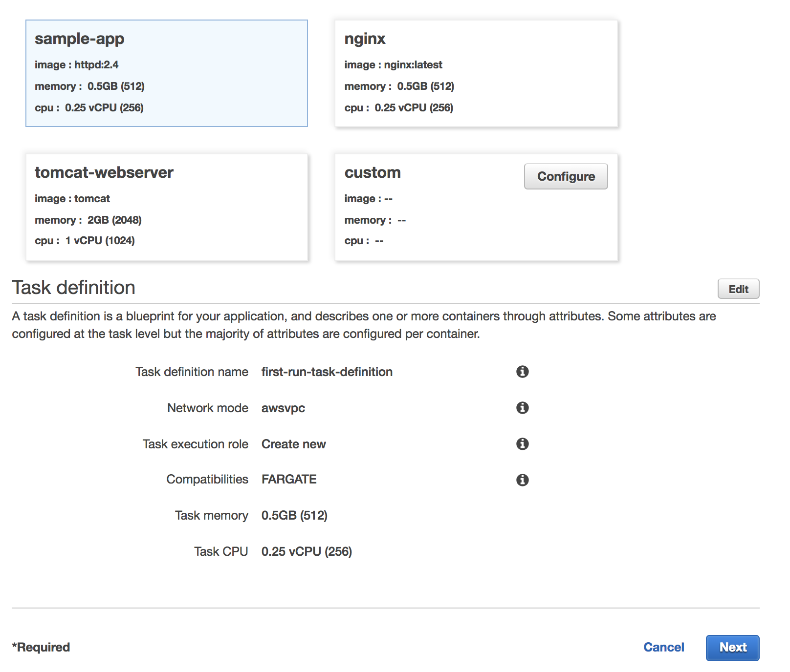
Setting up Logging for ECS
Step 6 of 10
Click Next

Slide 10
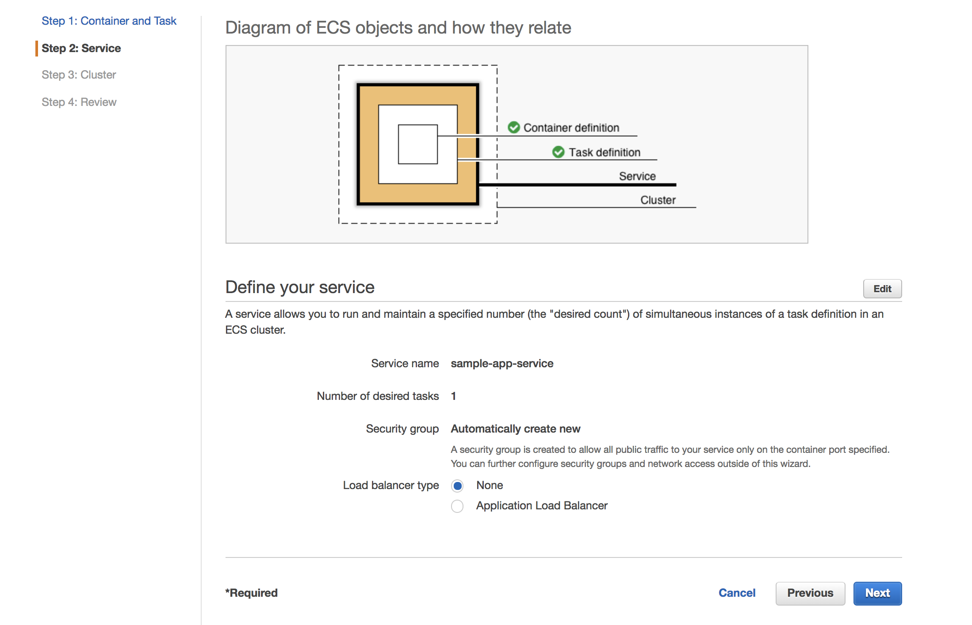
Setting up Logging for ECS
Step 7 of 10
Click Next

Slide 11
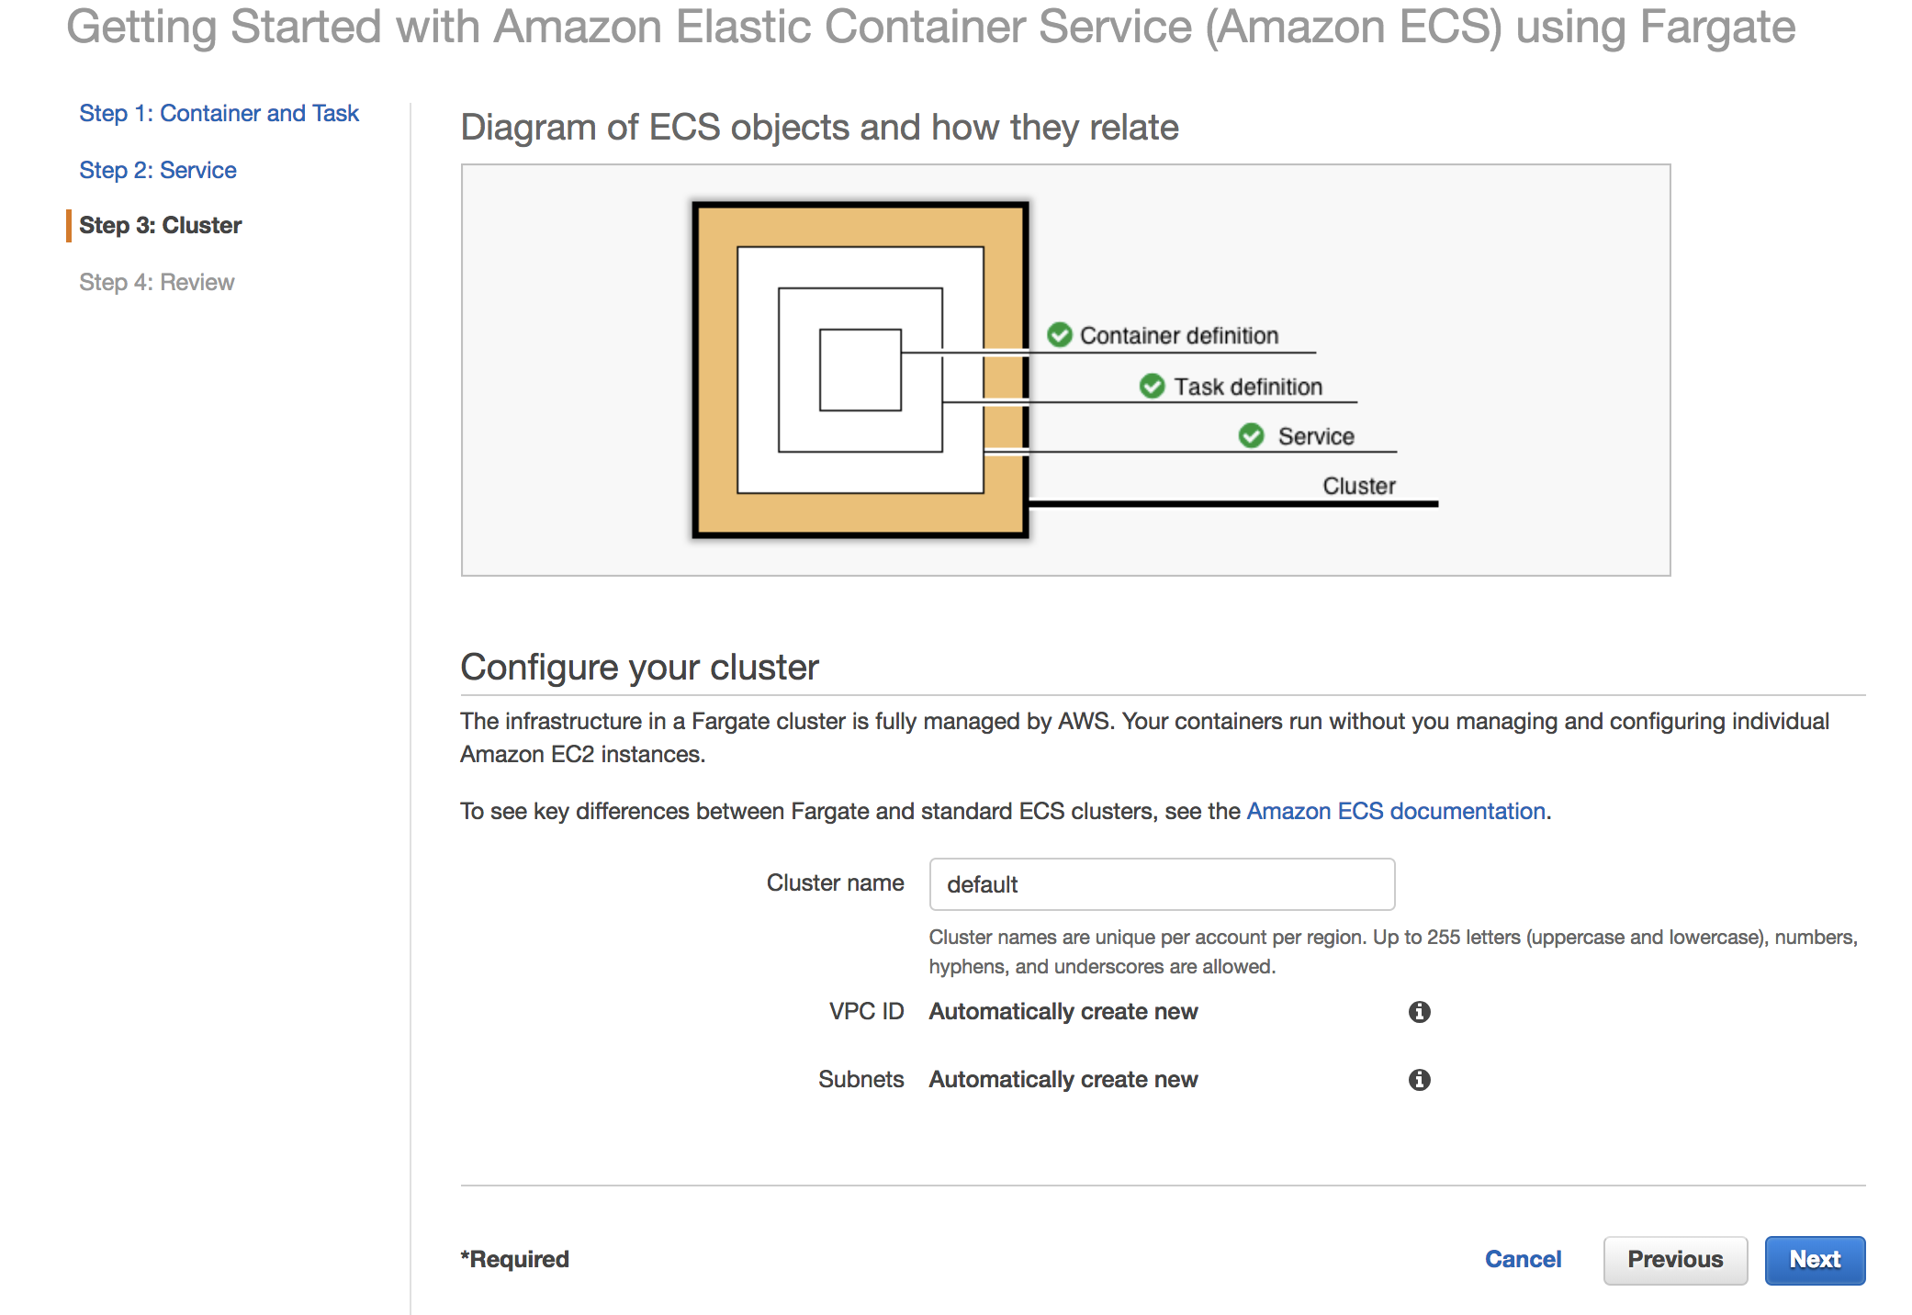
Setting up Logging for ECS
Step 8 of 10
Click Next

Slide 12
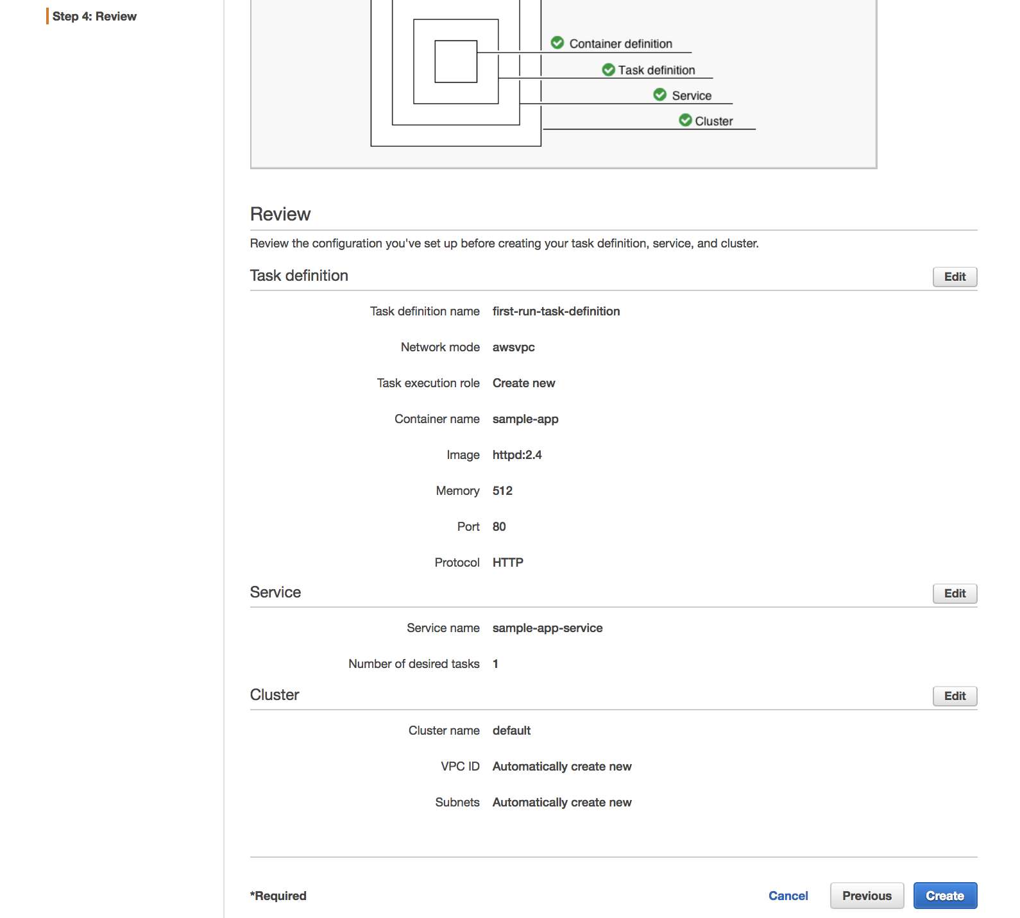
Setting up Logging for ECS
Step 9 of 10
Review Configurations and click Create

Slide 13
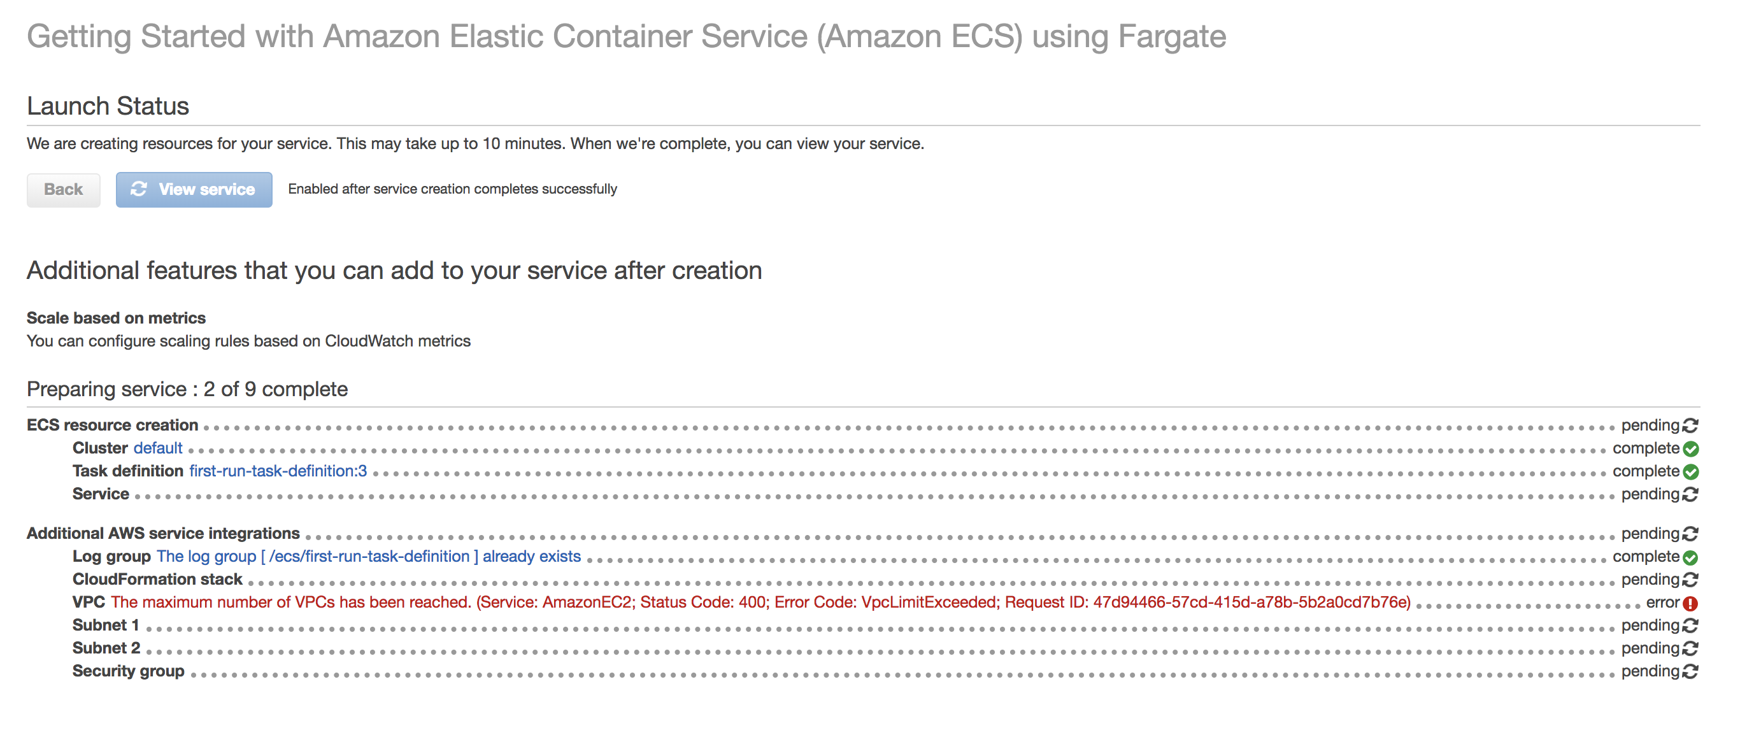
Setting up Logging for ECS
Step 10 of 10
Wait for Cluster to be created

Slide 14
CloudWatch Logs Approach
Native setup using CloudWatch Log agent

Slide 15
Lambda to Splunk HEC
Create a lambda function based on the “splunk-cloudwatch-logs-processor”
Trigger the Lambda Function to the CloudWatch Log Group created in step 5
Send the data to the Splunk HEC URL with the token

Slide 16
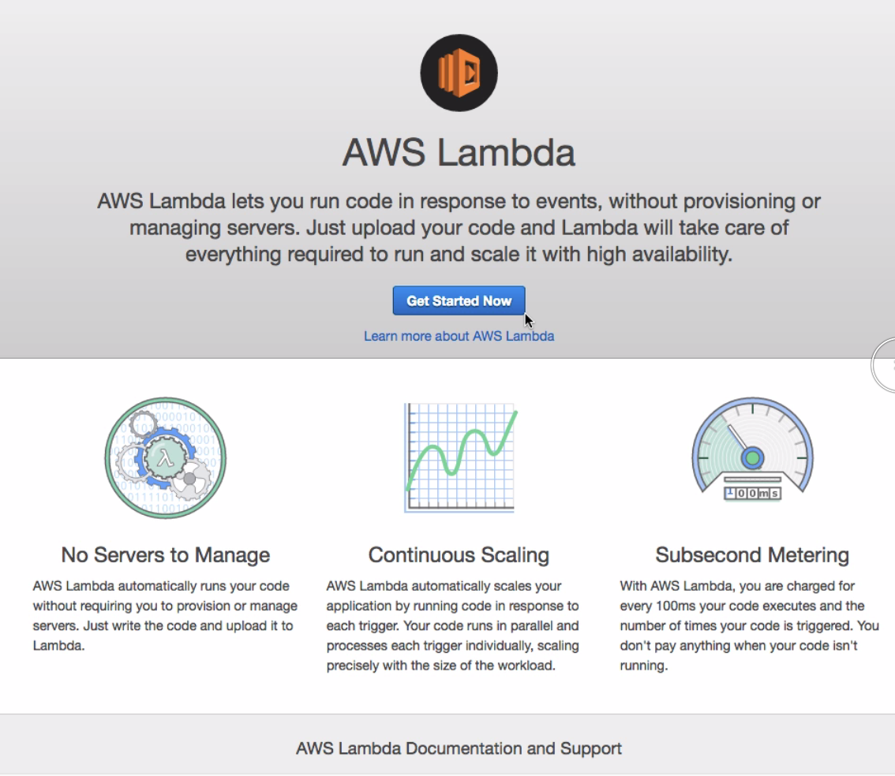
Create the Lambda Function (1 of )
Click Get Started

Slide 17
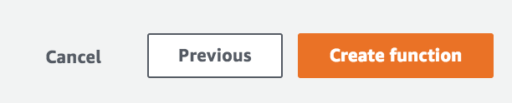
Create the Lambda Function (2 of 10)
Click Create Function

Slide 18
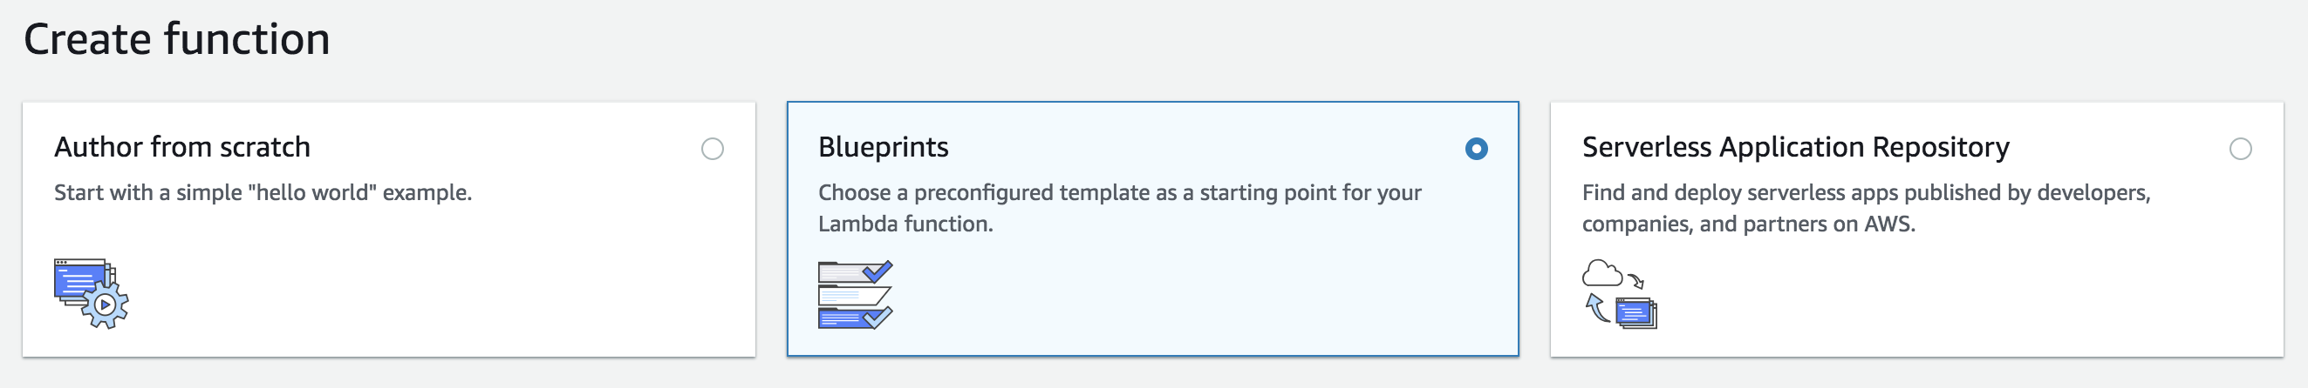
Create the Lambda Function (3 of 10)
Select Blueprints

Slide 19
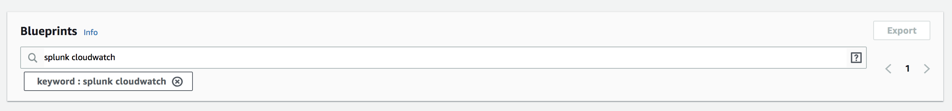
Create the Lambda Function (4 of 10)
Filter for “splunk cloudwatch”

Slide 20
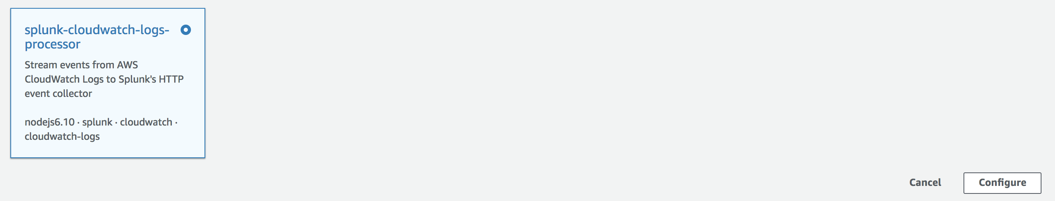
Create the Lambda Function (6 of 10)
Select “splunk-cloudwatch-logs-processor” function
Click Configure

Slide 21
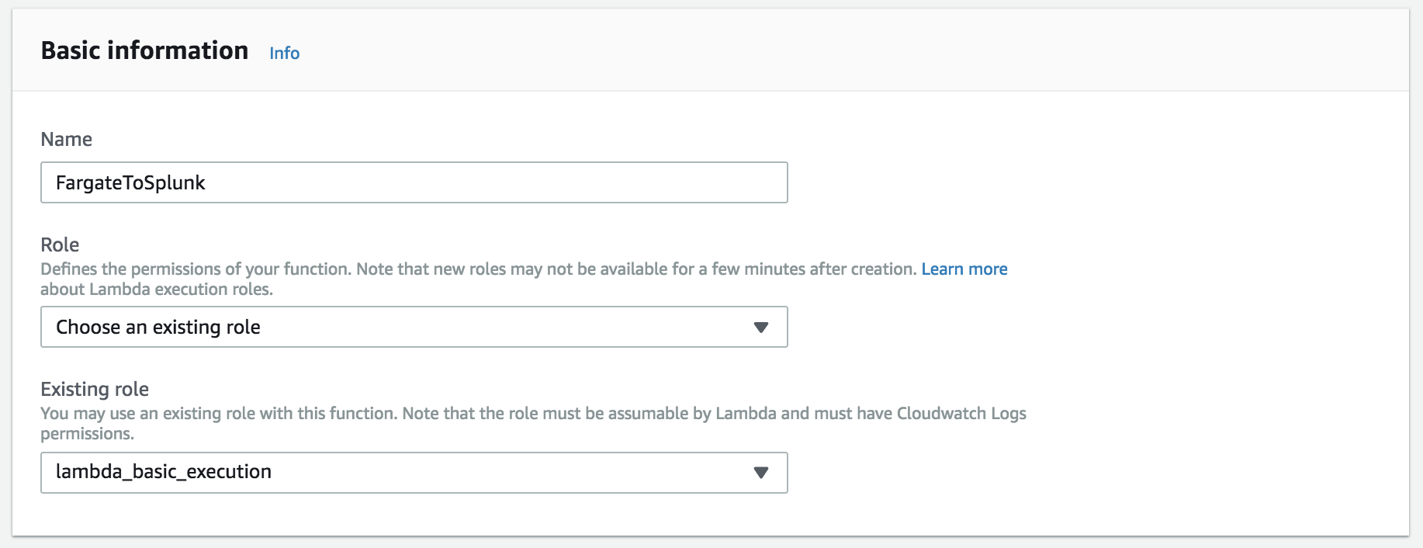
Create the Lambda Function (7 of 10)
Name the function and select an IAM role
** If you do not have an existing role, see the appendix on how to create the role.

Slide 22
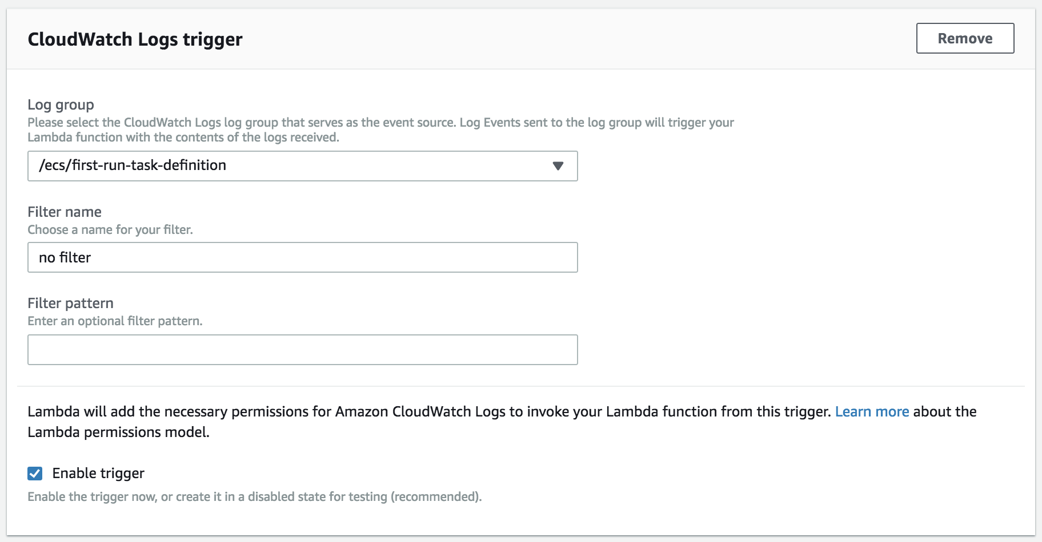
Create the Lambda Function (8 of 10)
Select the CloudWatch Log Group for your ECS cluster
Click the dropdown and select the ecs cloudwatch log group.
Enable the Trigger

Slide 23
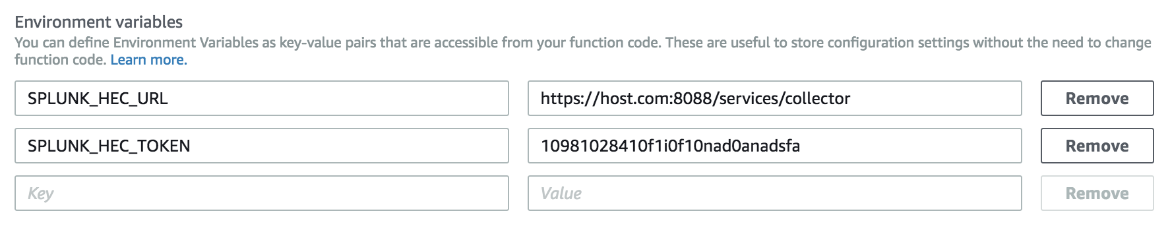
Create the Lambda Function (9 of 10)
Enter your HEC URL and Token

Slide 24
Create the Lambda Function (10 of 10)
Click on Create Function

Slide 25
Sidecar with Docker Logging Library
FUTURE

Slide 26
Appendix

Slide 27
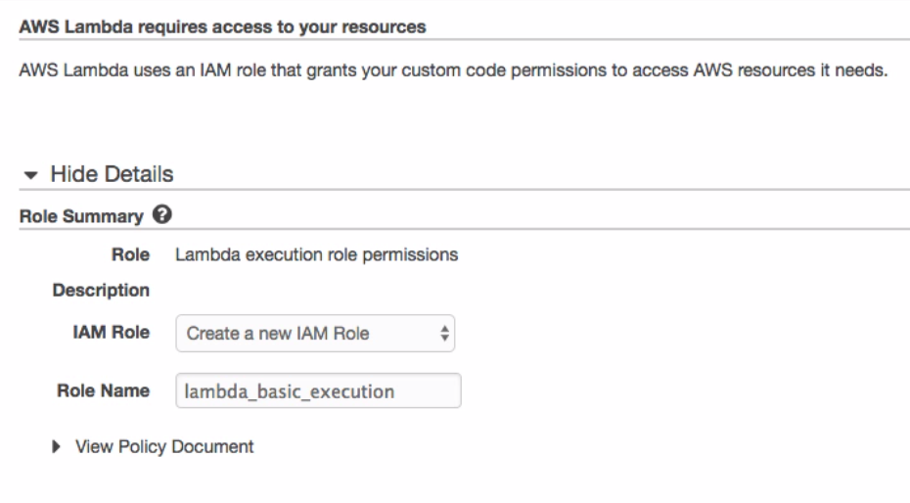
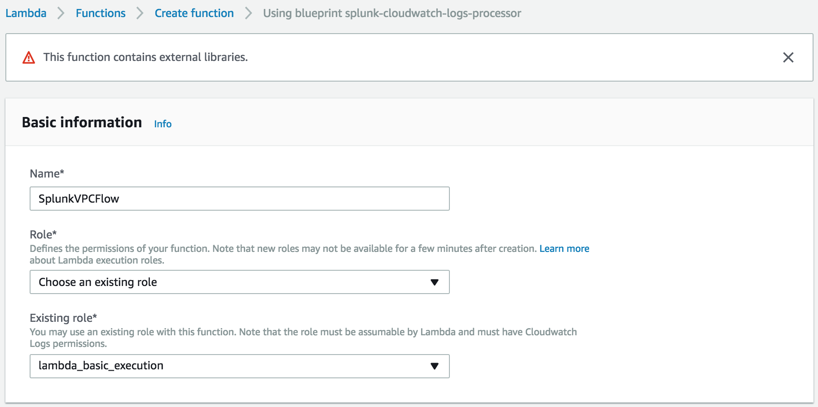
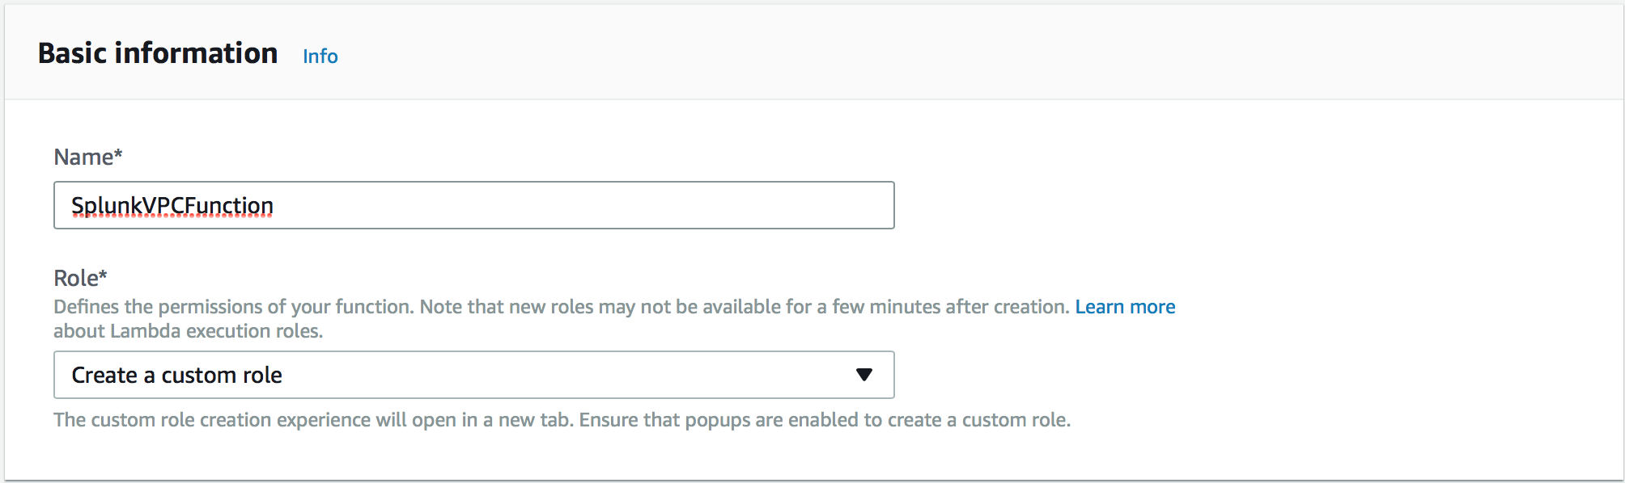
Lambda – How to create custom role
Create IAM Role with Lambda Execution enabled
New Custom
IAM Role
Create Role
Enable Lambda Function
1) Select “Create a new role”
2) Create lambda_basic_execution
Click Allow
3) Validate that the new role ‘lambda_basic_execution’ is selected and select your CloudWatch Log group that will trigger this Lambda Function.
Notes:
1) Once you’ve selected “Create new role,” you will be taken to a new tab where the ‘lambda_basic_execution’ role has been created for you. 2) Click on allow and then go back to your screen for creating the Lambda function, select the newly created role ‘lambda_basic_execution.’ 3) Select the CloudWatch Log group you created earlier, VPCFlowLogsGroup, that will trigger this Lambda function.

Slide 28
Continue to Module 11: Sizing AWS Environment
Please Contact Kam Amir kam@splunk.com

